Slide 1


Slide 2


Slide 3
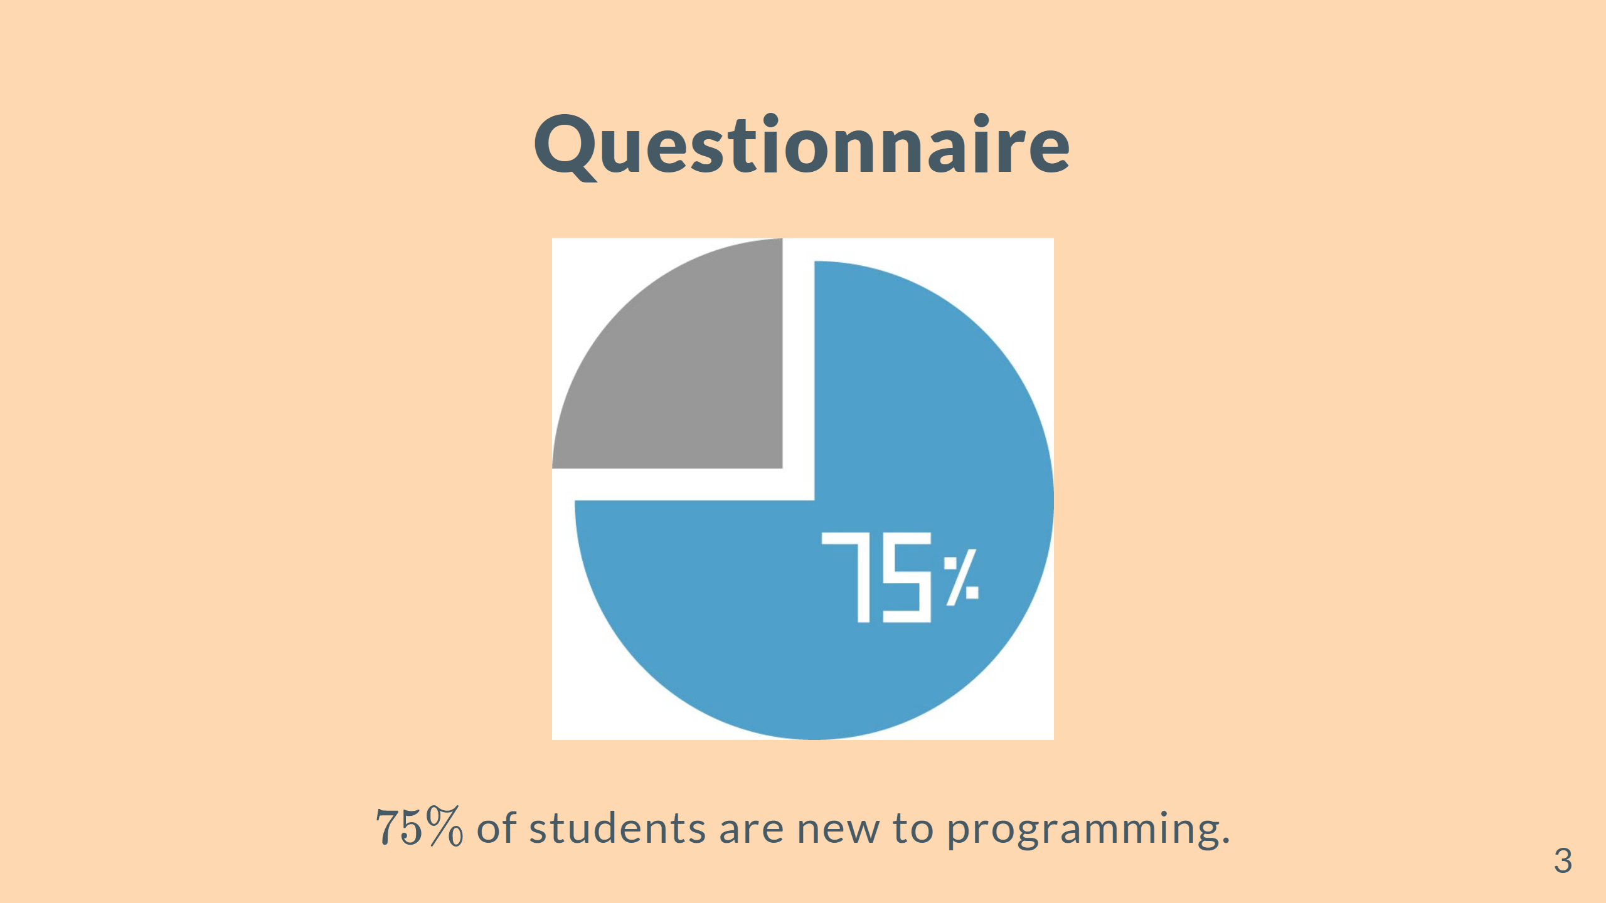

Slide 4


Slide 5
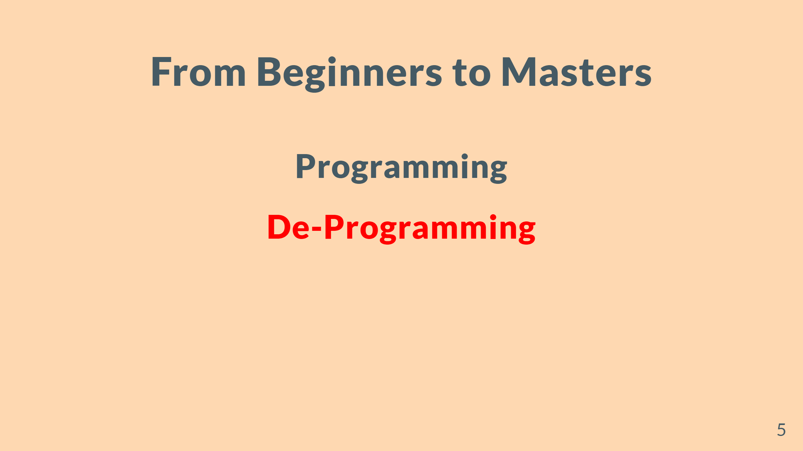

Slide 6


Slide 7


Slide 8


Slide 9
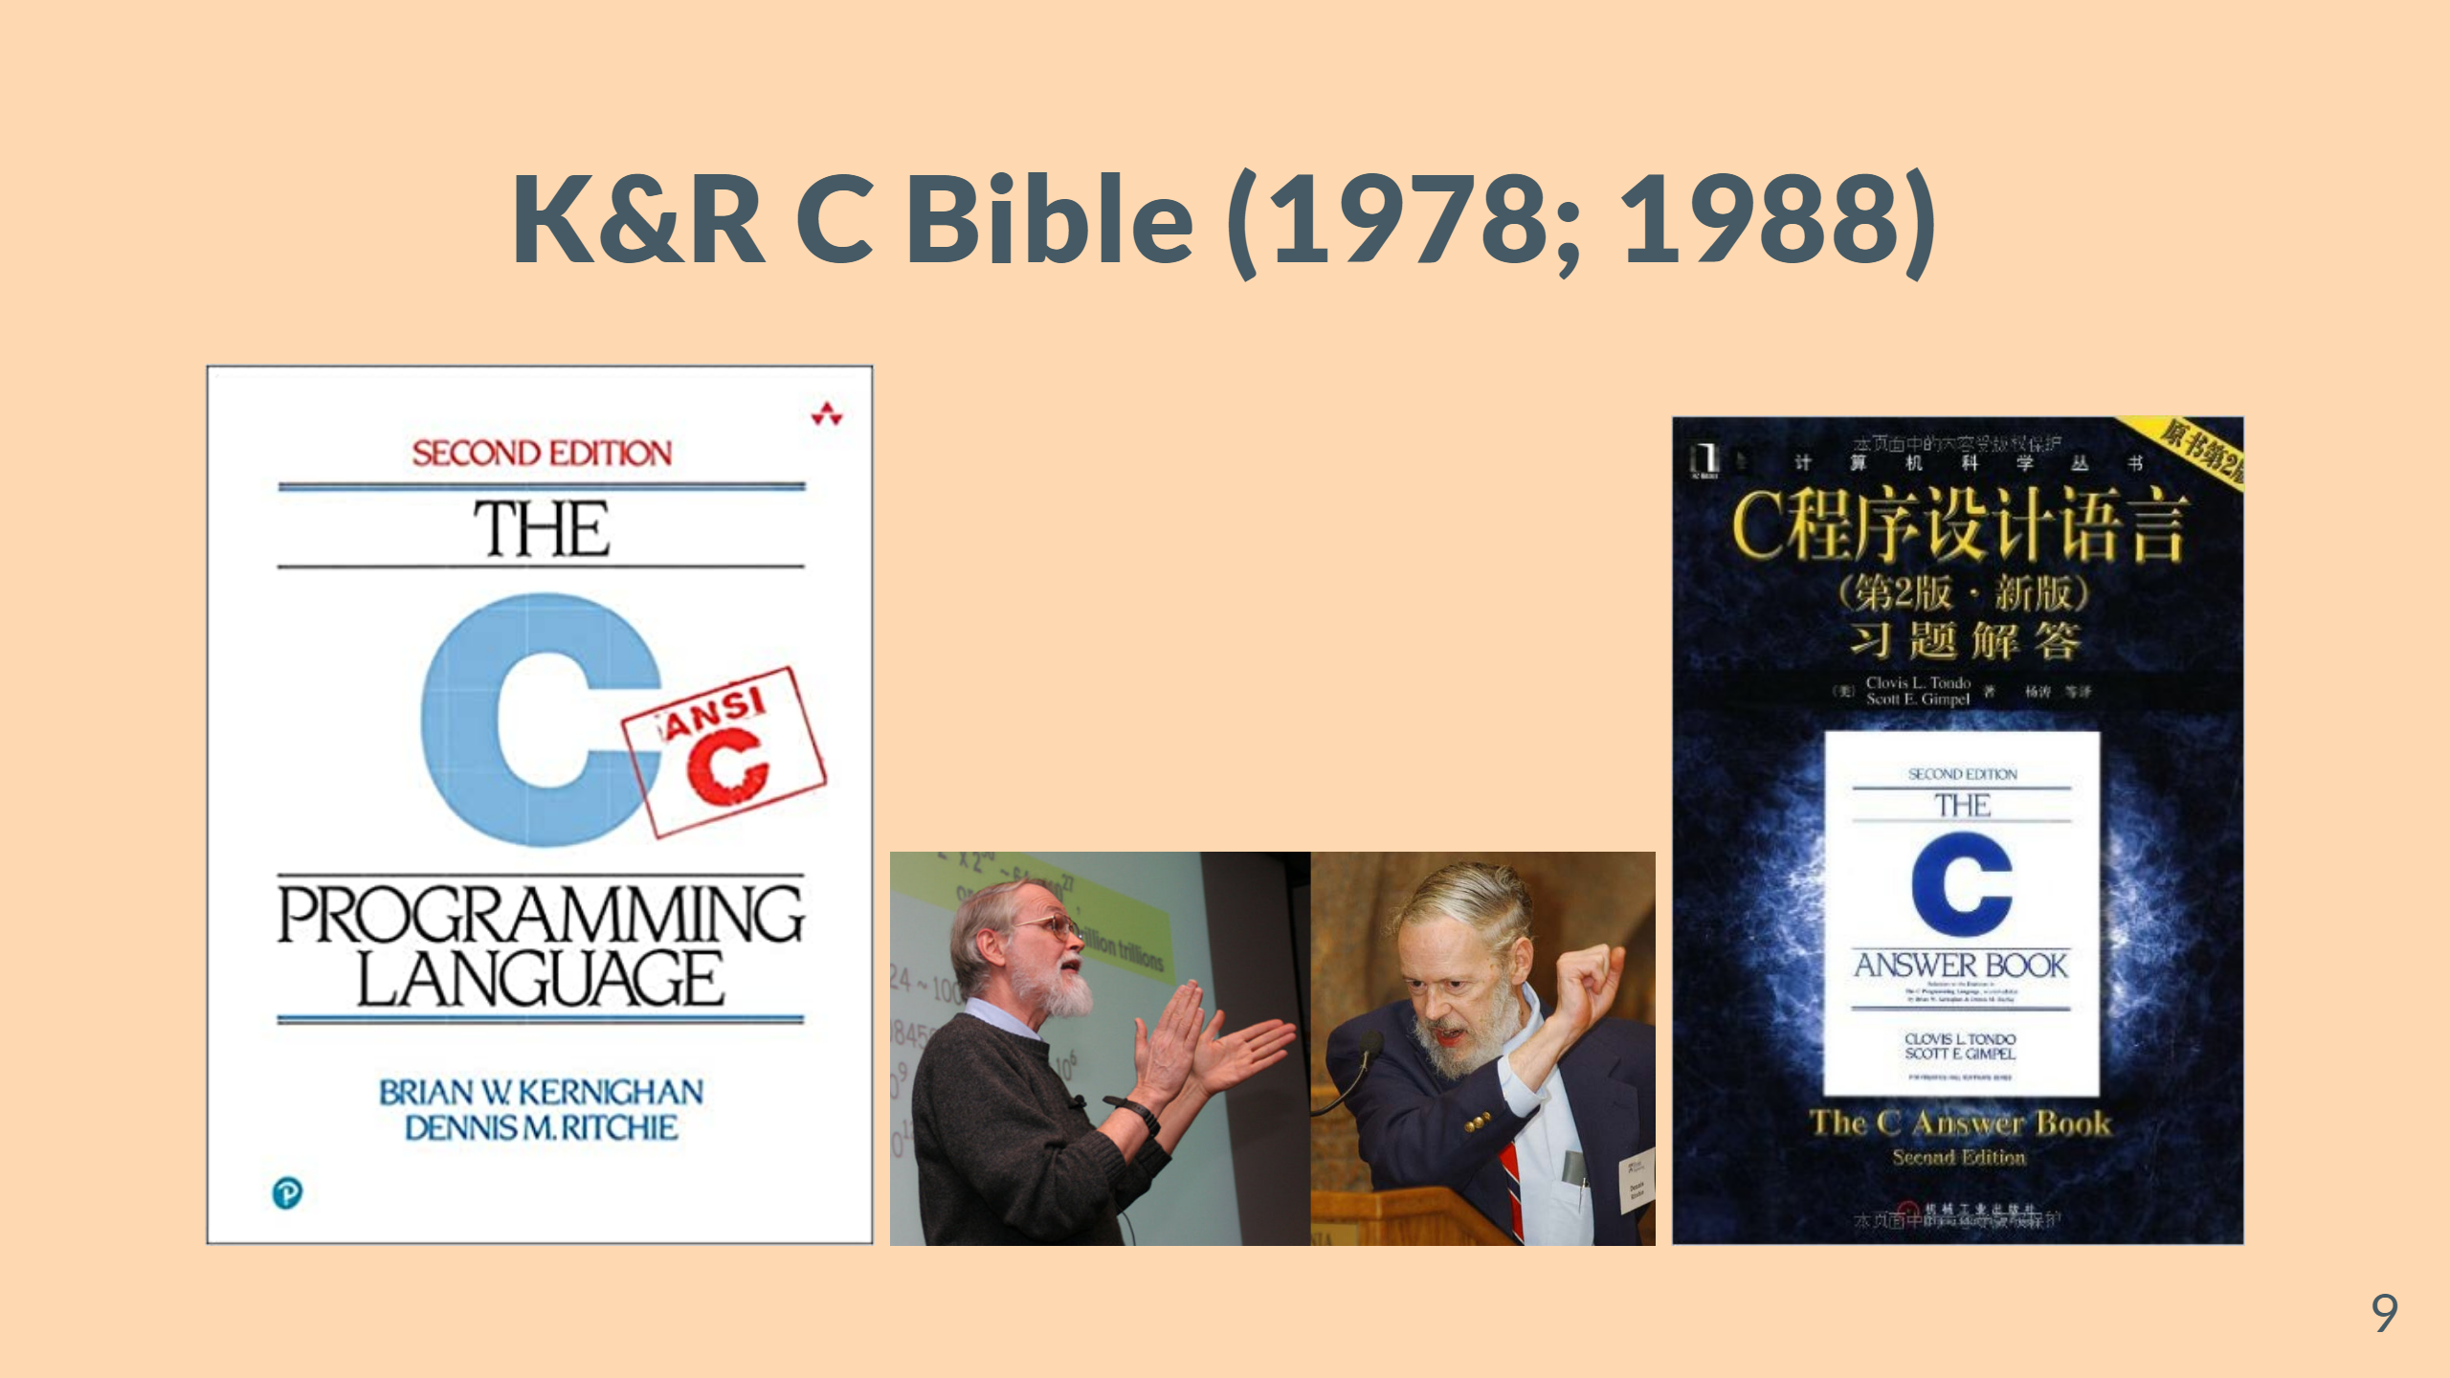
Notes:
#### Not for Beginners

Slide 10
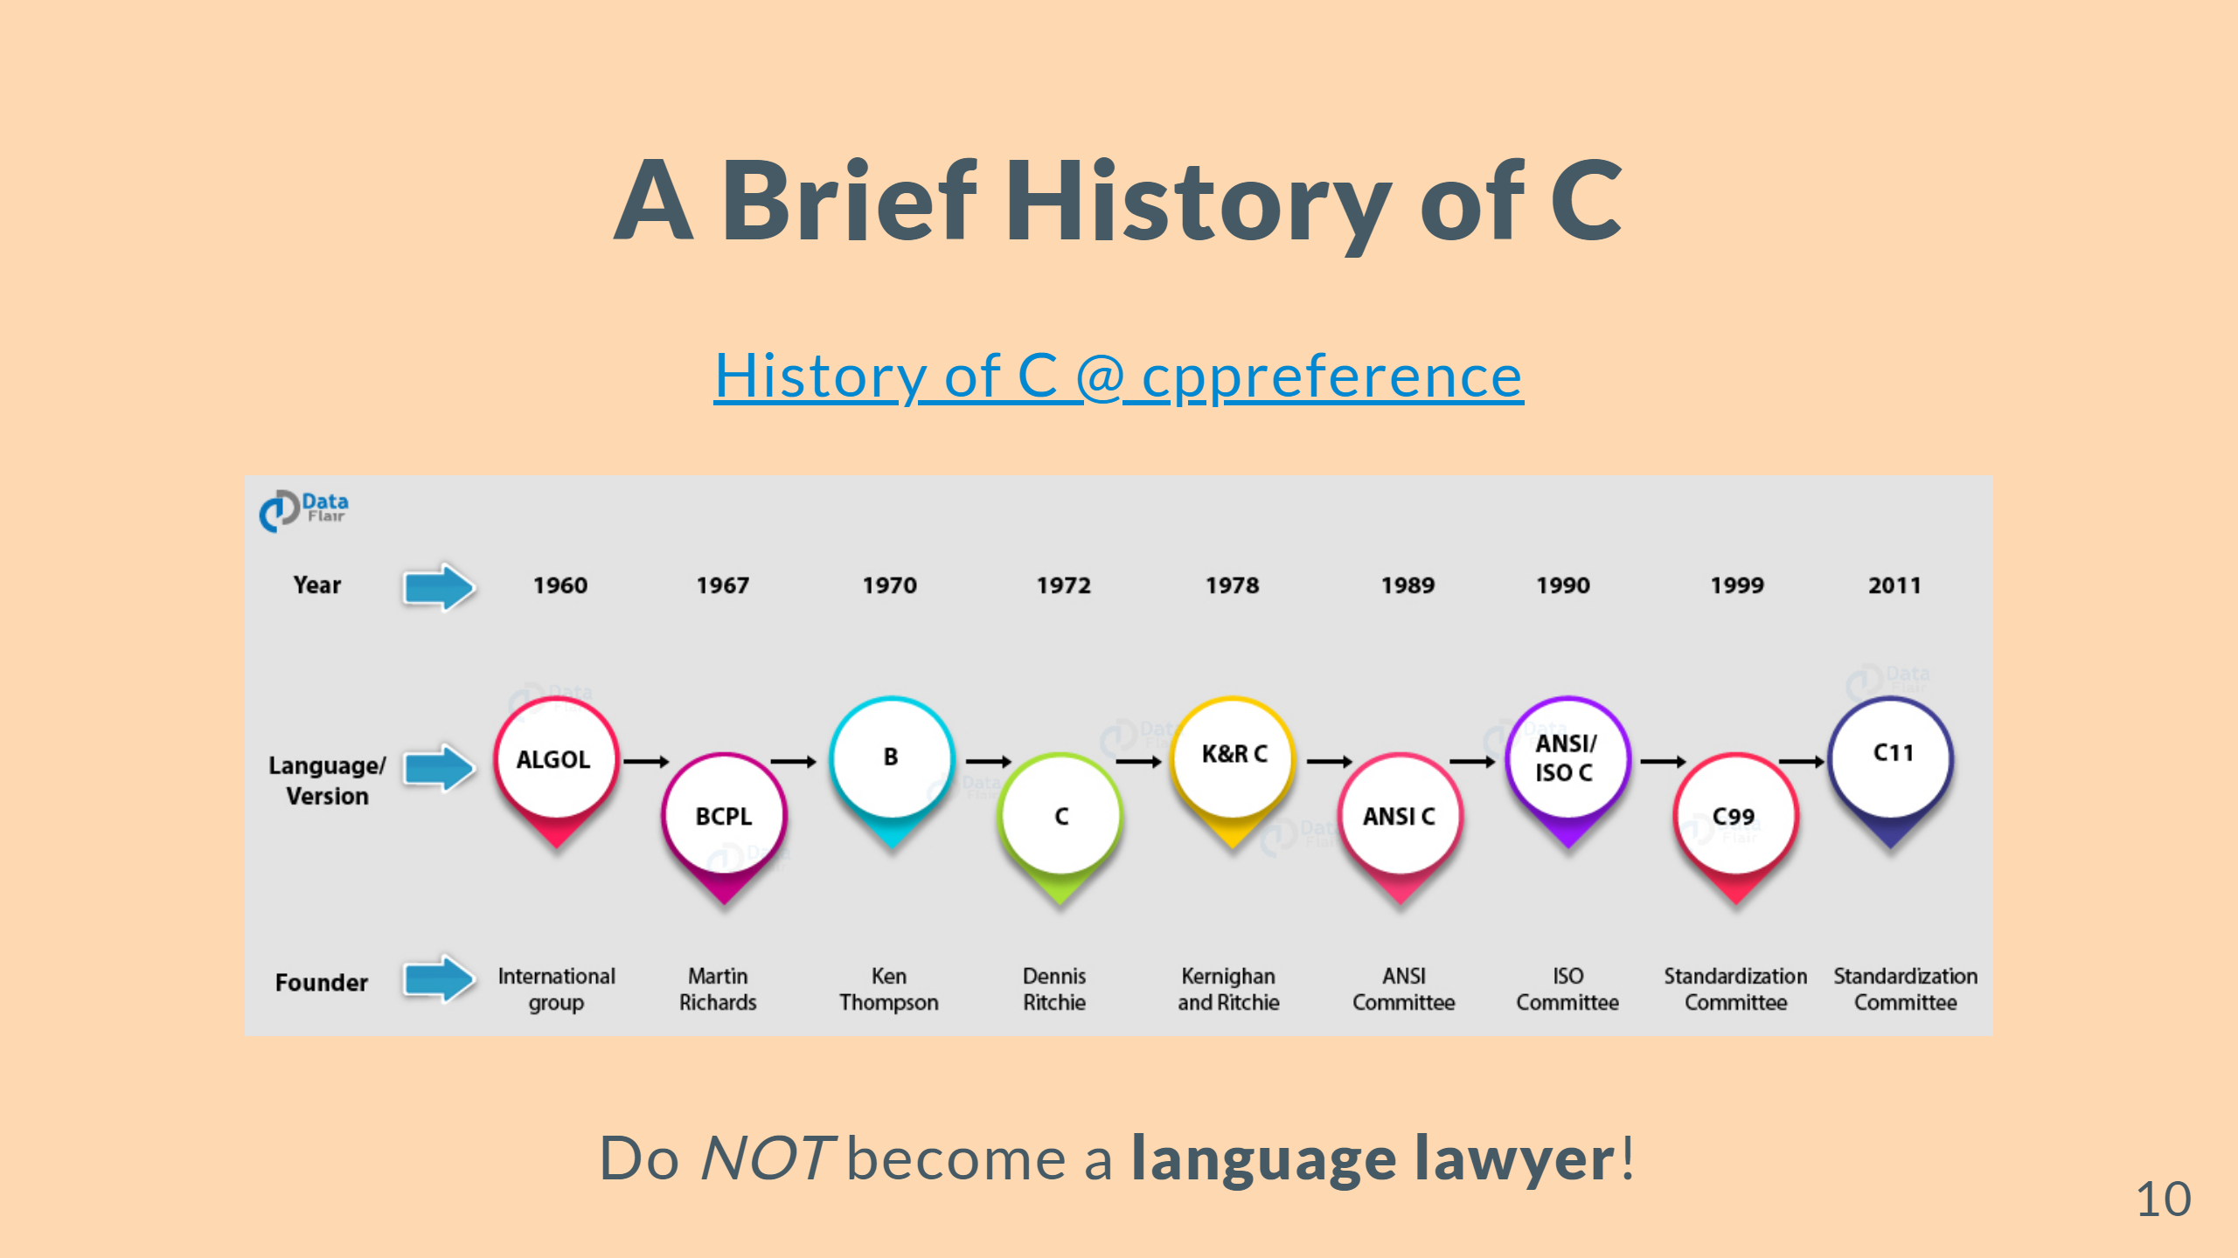
Notes:
--- ![bg 70%](figs/c-primer-plus-ch.jpg) ![bg 72%](figs/c-primer-plus-en.jpg)

Slide 11


Slide 12
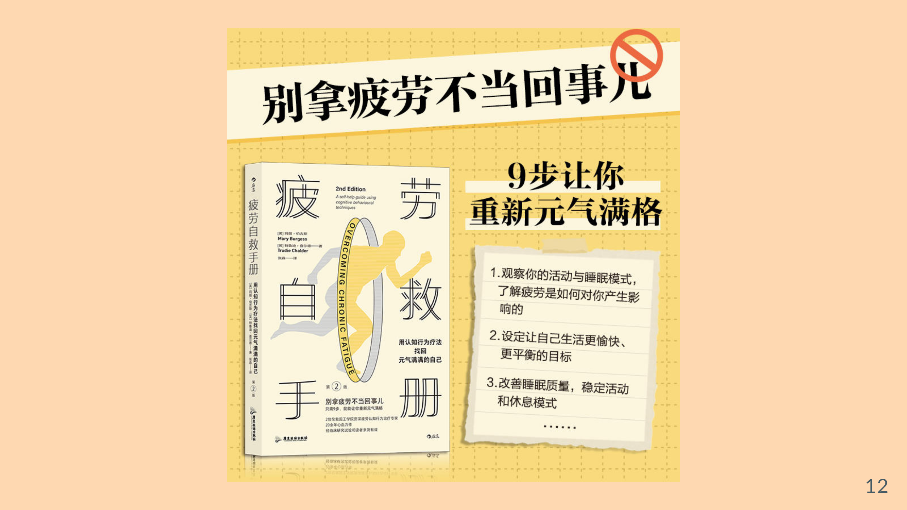

Slide 13


Slide 14

Notes:
--- ![bg 80%](figs/CLion2021.png)

Slide 15
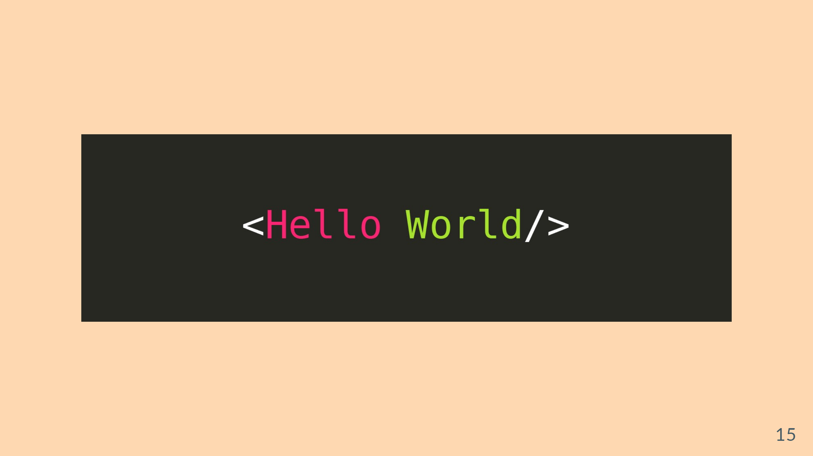

Slide 16
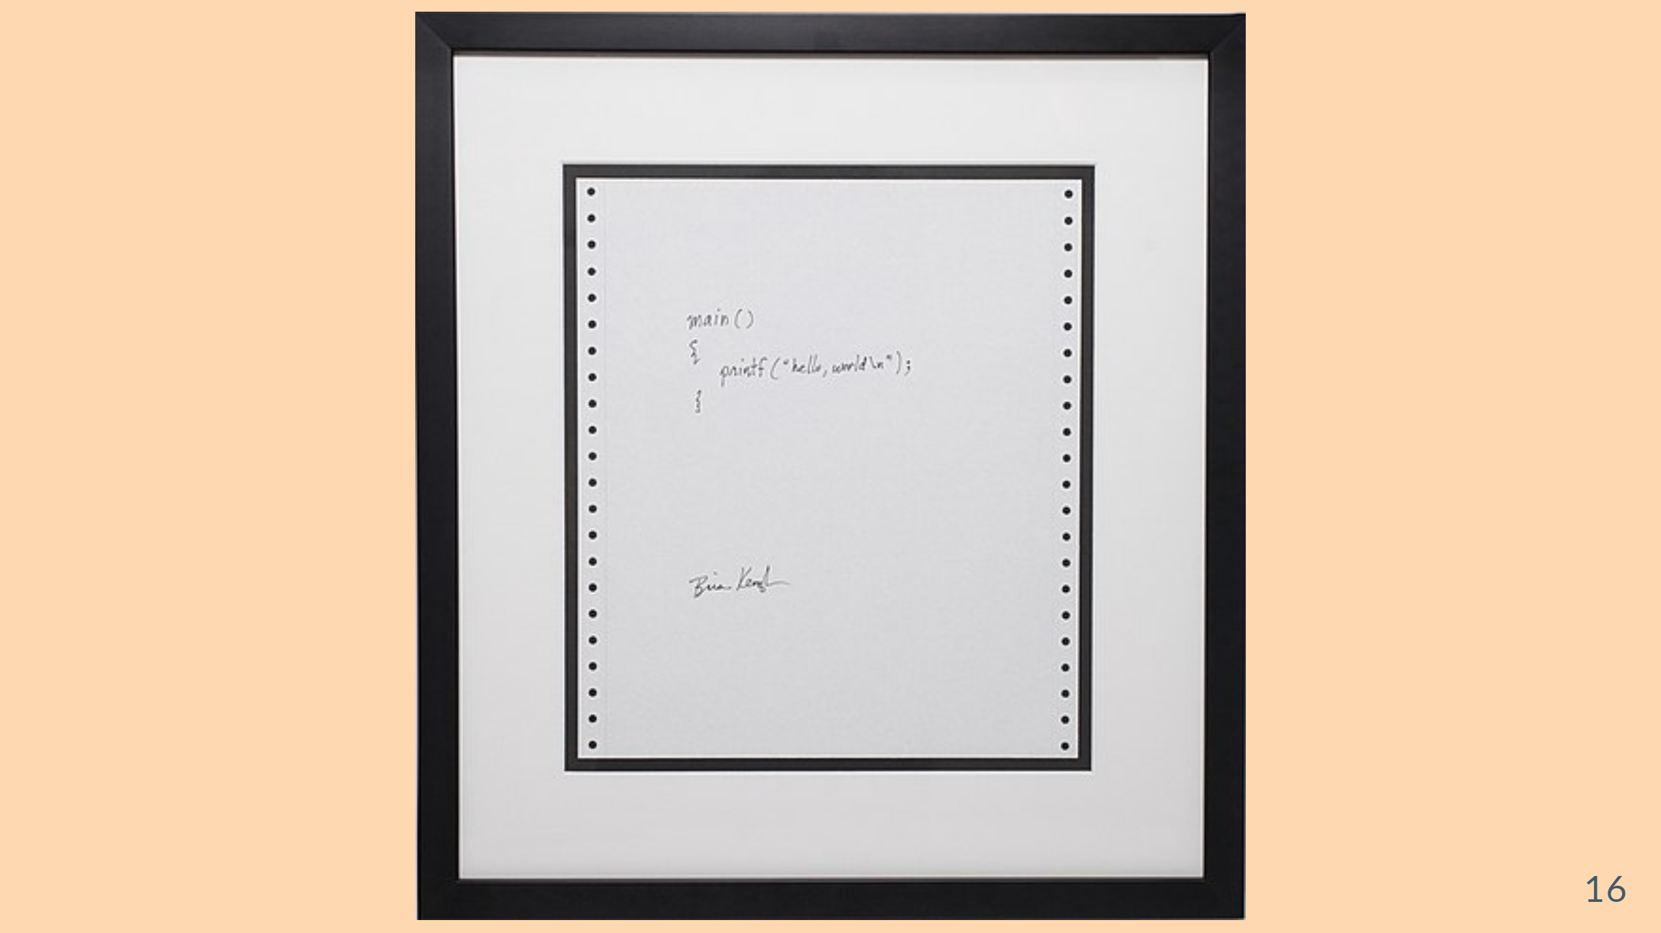

Slide 17
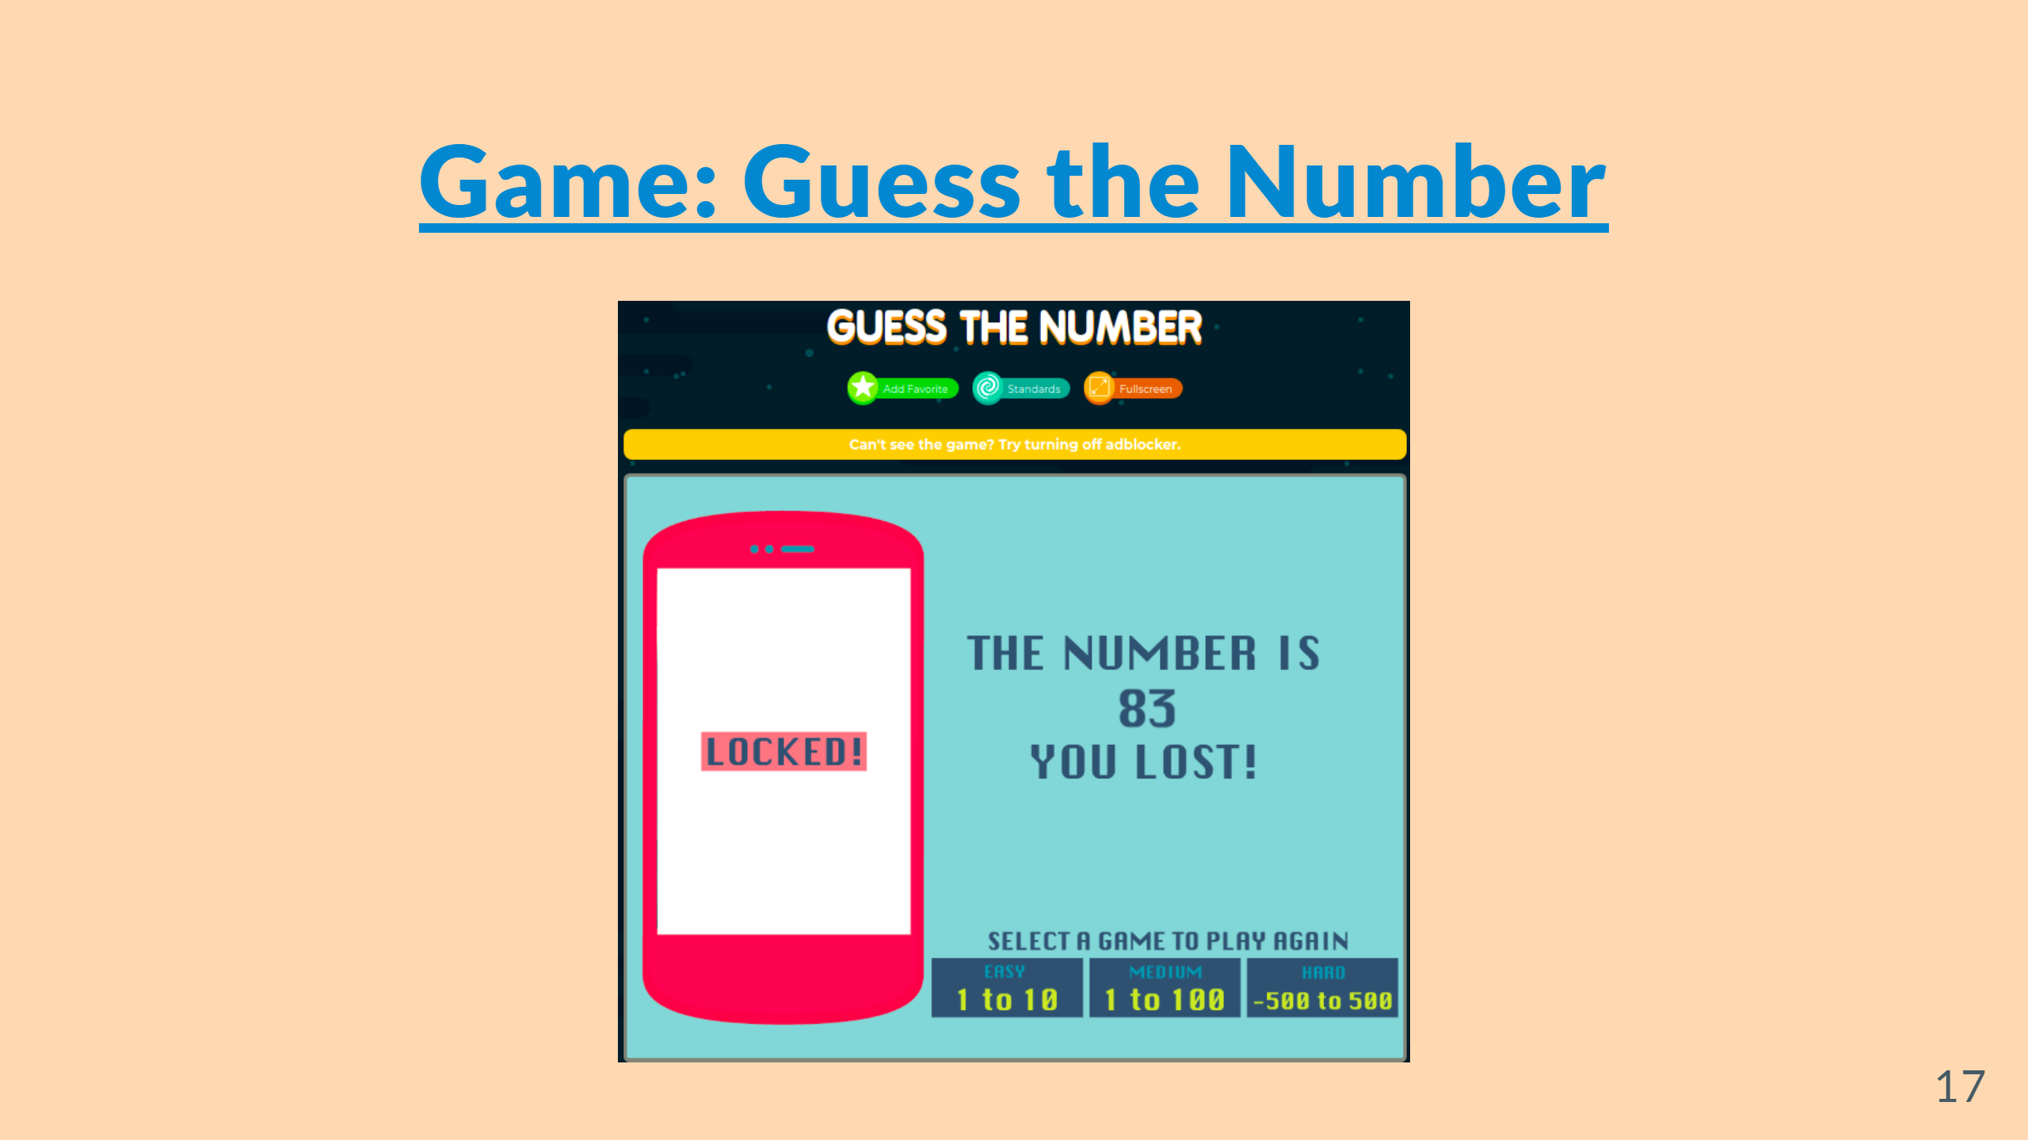

Slide 18
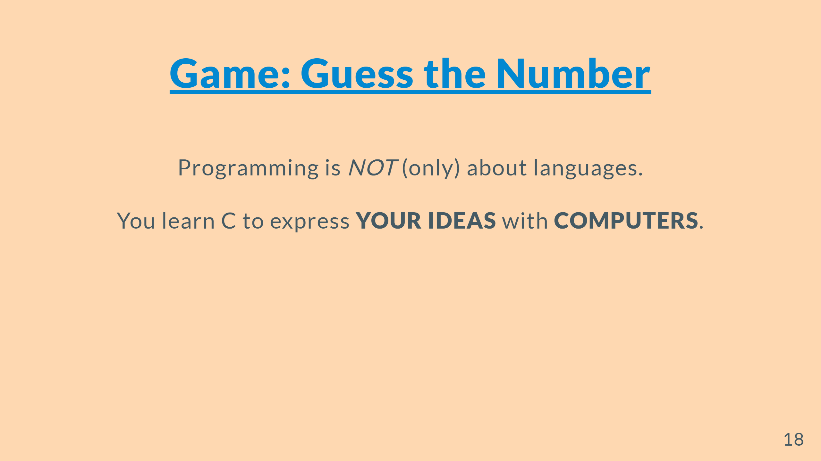

Slide 19
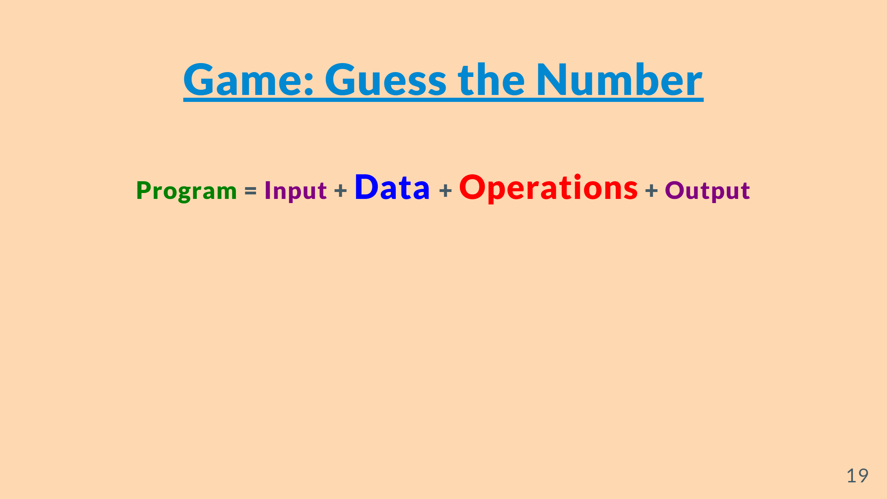

Slide 20
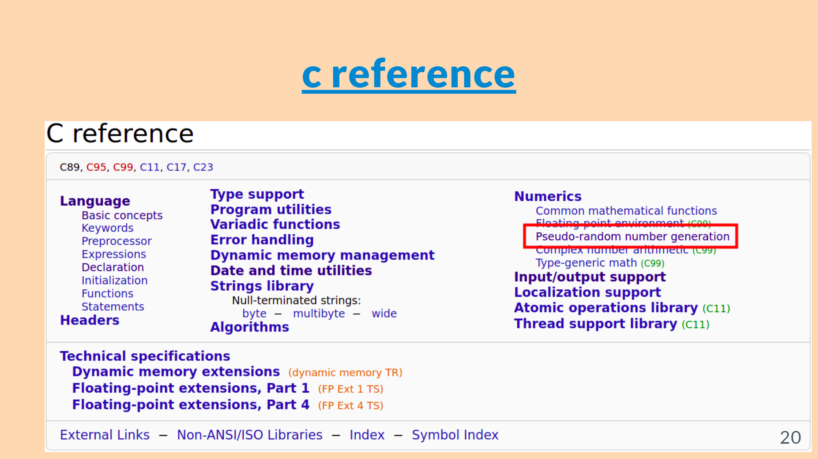

Slide 21
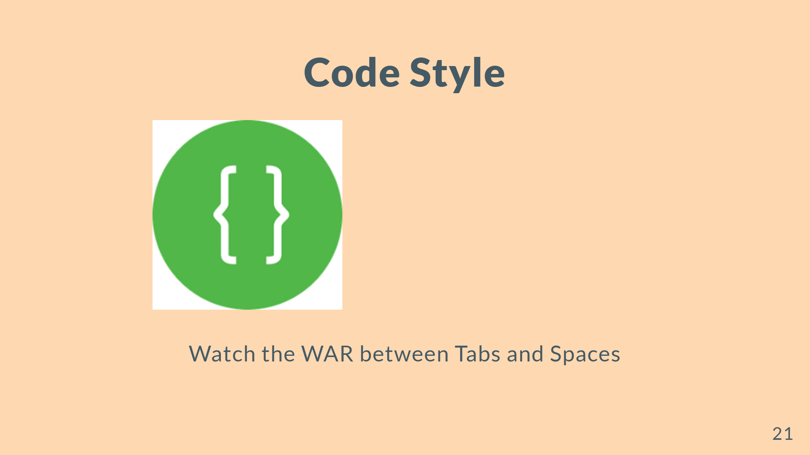

Slide 22
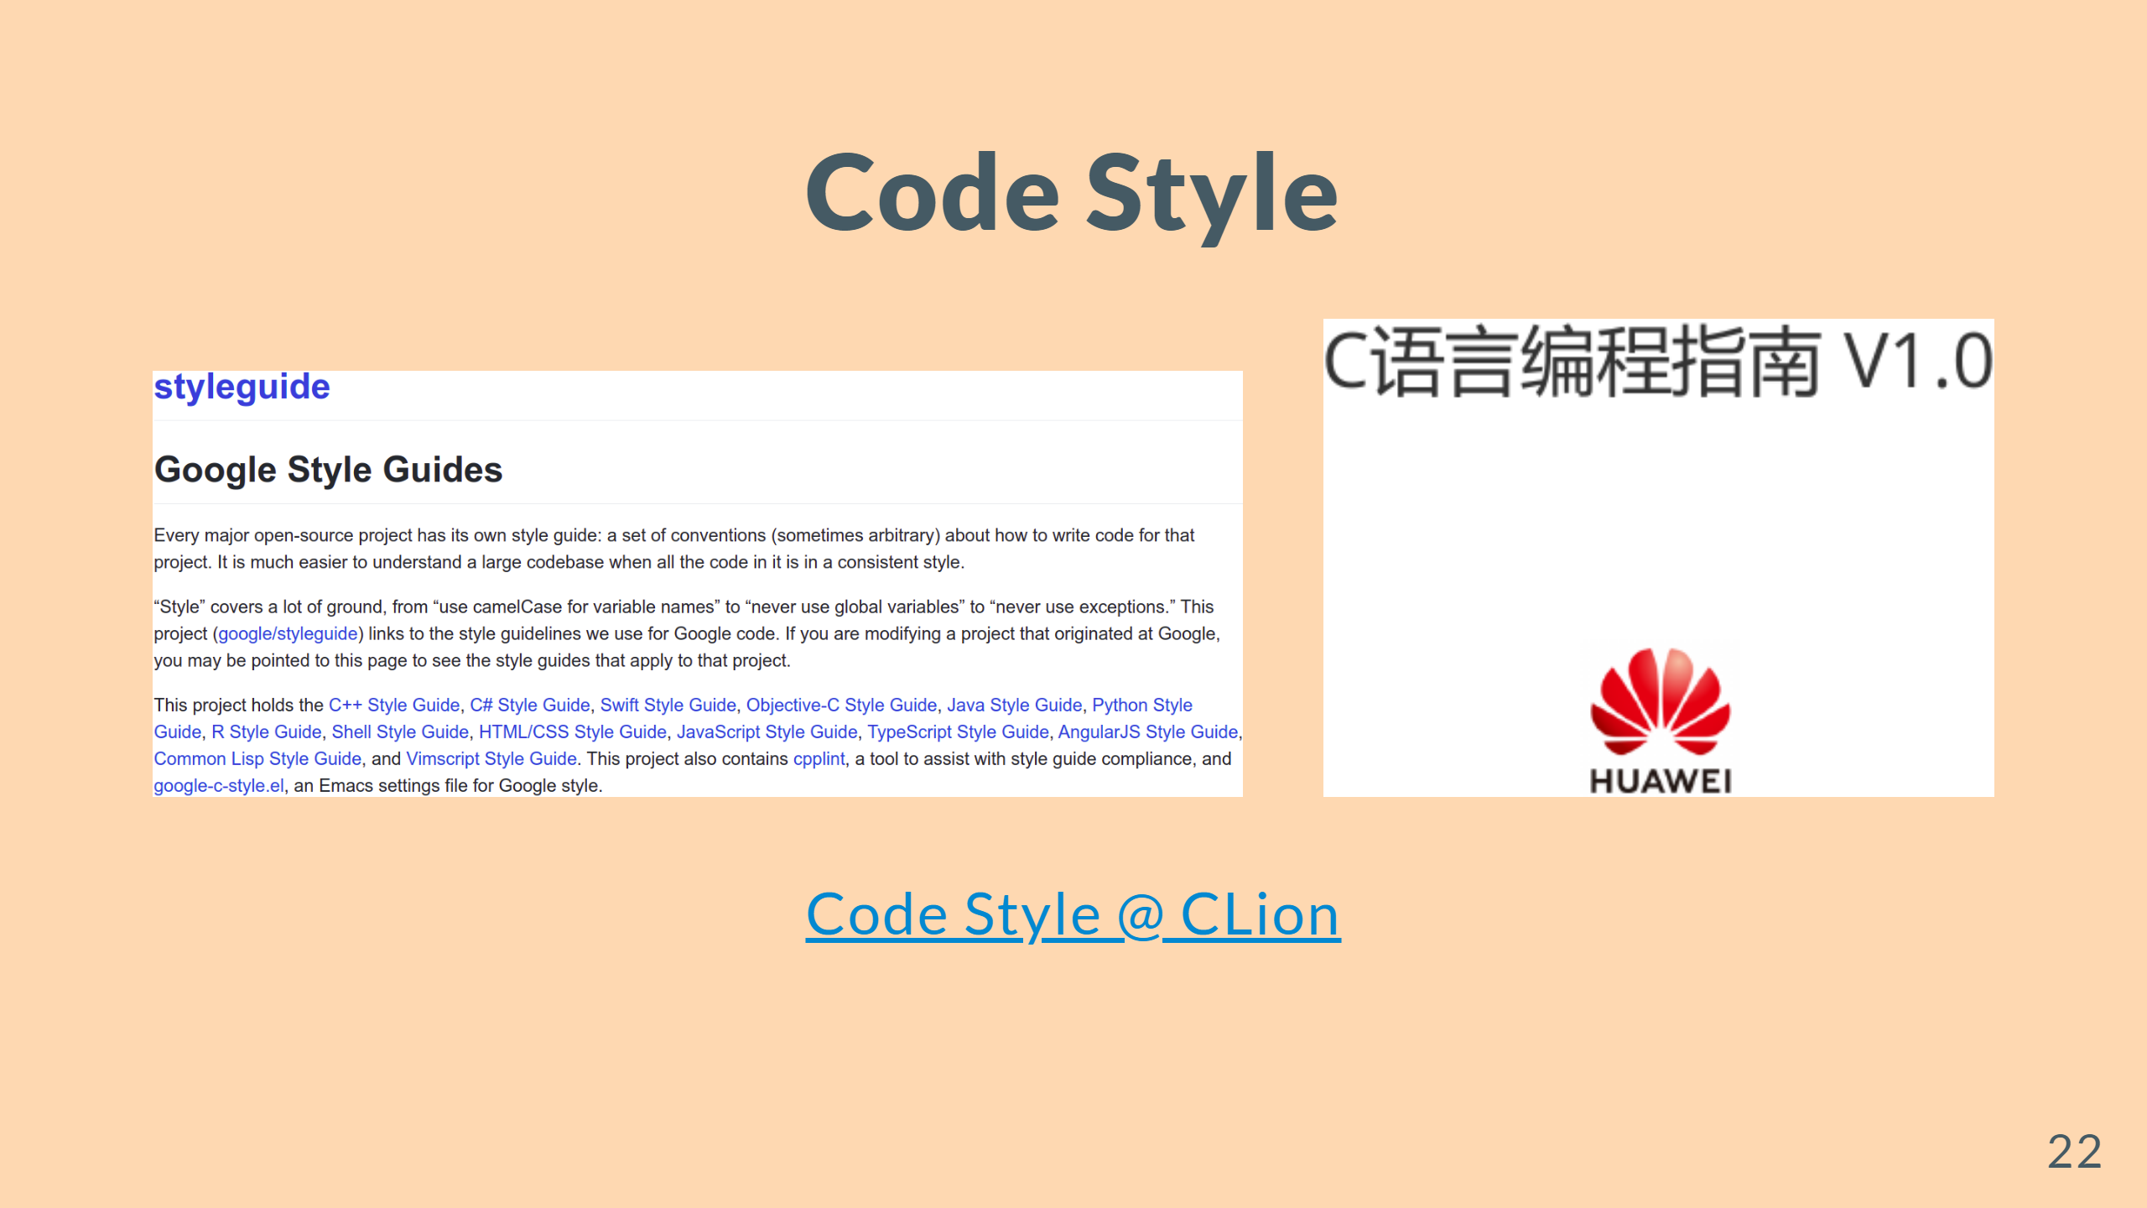

Slide 23


